Slide 1
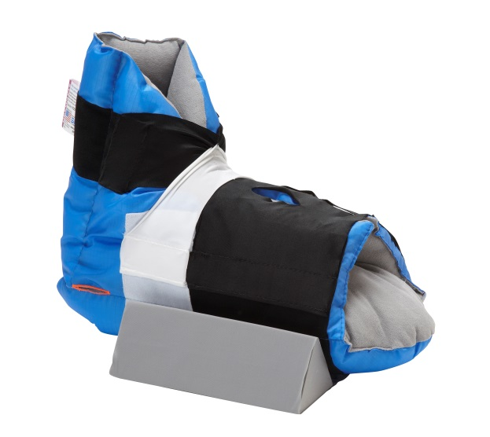
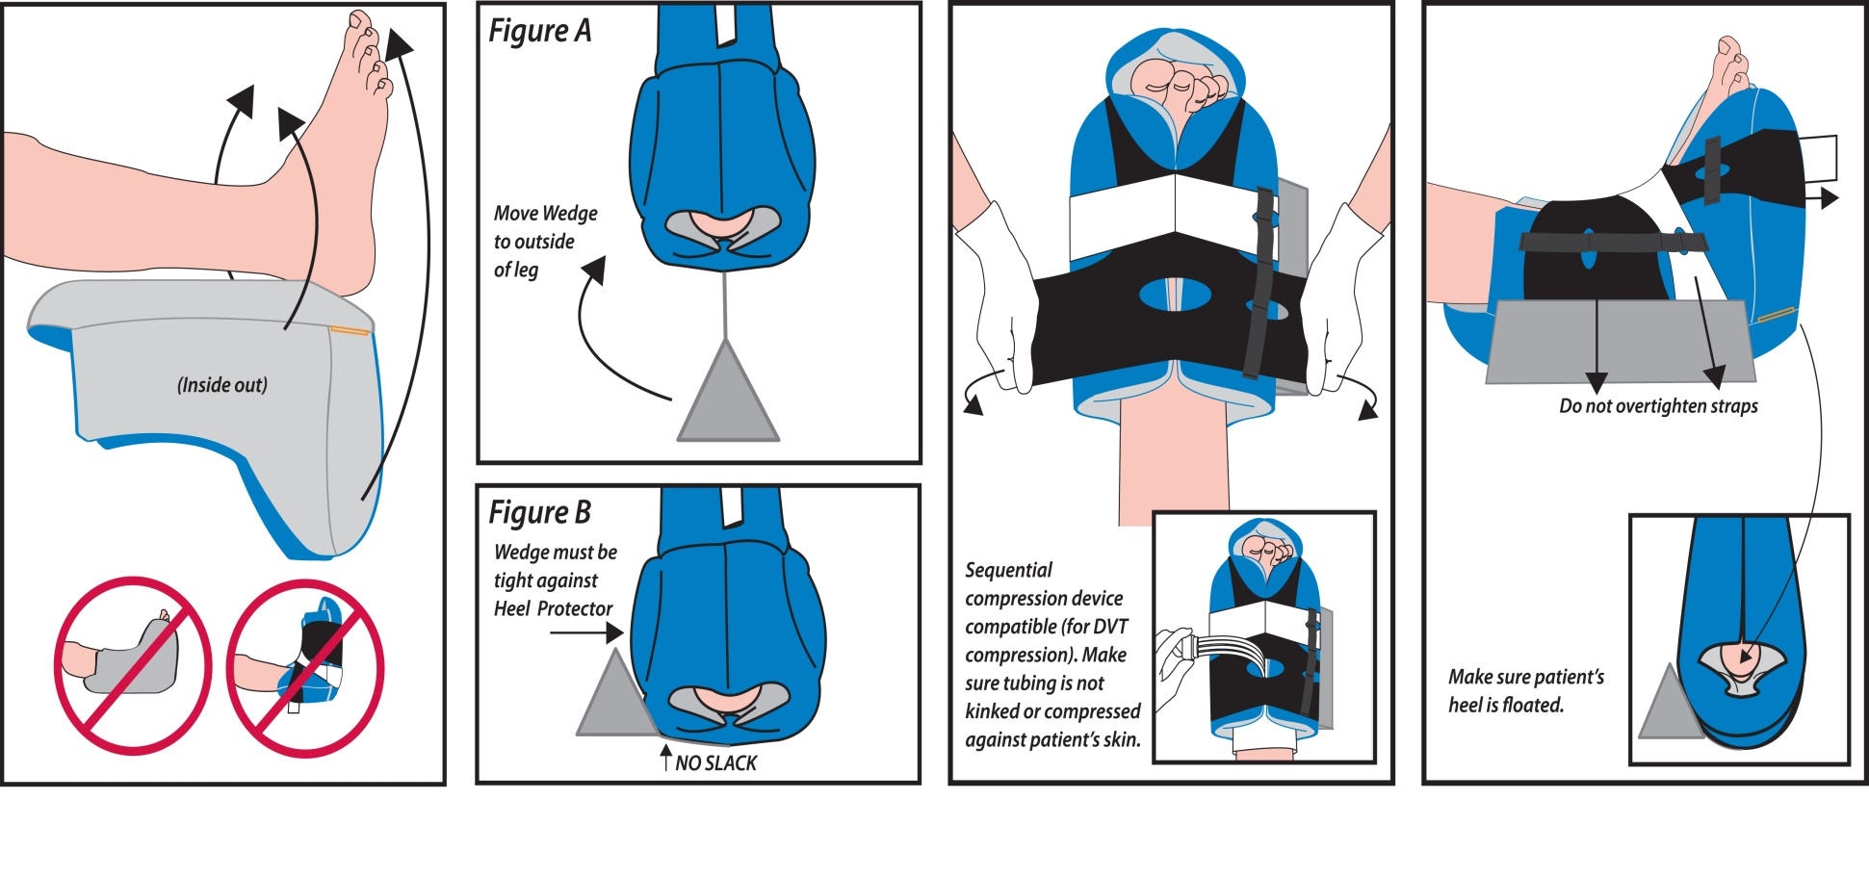

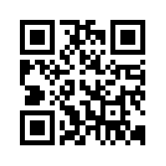
Prevalon
®
Pressure-Relieving Heel Protector
with Integrated Foot & Leg Stabilizer Wedge
Instructions for Use: Prevalon Standard Size
3
4
Position heel over opening.
Pull Heel Protector up around
foot. Pull front of Heel Protector
up around toes.
Position Integrated Wedge
on outside of leg (lateral side).
Apply pressure to the side of
Heel Protector and reposition
as appropriate.
Wrap stretch panels around boot.
Adjust straps accordingly.
DO NOT overtighten.
ORDERING CODES
PREVALON® PRESSURE-RELIEVING HEEL PROTECTOR with Integrated Wedge
Standard size fits 25-46cm calf circumference.
8 heel protectors/case.
Order Code: #7355-X
PREVALON® PRESSURE-RELIEVING HEEL PROTECTOR
Standard size fits 25-46cm calf circumference.
8 heel protectors/case.
Order Code: #7300-X
PREVALON® PETITE PRESSURE-RELIEVING HEEL PROTECTOR
Standard size fits 15-25cm calf circumference.
8 heel protectors/case.
Order Code: #7310-X
CAUTION: For use on patient while in bed. DO NOT allow patient to stand or walk while wearing.
Periodically remove Prevalon® to assess skin according to protocol.
Cleaning Instructions: Prevalon® can be wiped clean with a damp cloth during use. Latex free.
Sales Specialist:
uksales@iskushealth.com
UK: +44 (0) 1256 365458 ROI: +353 (1) 404 8383 NI: +44 (0) 845 850 8600
E. info@Iskushealth.com www.iskushealth.com
ISK/171013/PREV/SJM

